Slide 1
Module 3 Guidance Notes C++ Basics
COMP2113 Programming Technologies
ENGG1340 Computer Programming II

Slide 2
SELF-REVIEW Problems
You should attempt all these problems and make sure that you can tackle them; if not, you should seek help from the teaching team.

Slide 3
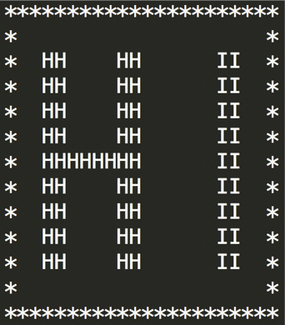
Problem 1
031001
Write a program that prints HI in large block letters inside a border of *. The output should appear as follows:

Slide 4
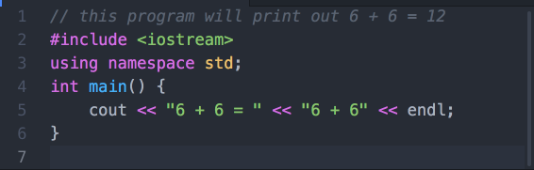
Problem 2
031002
The following program is supposed to print out 6 + 6 = 12
Unfortunately, it doesn’t. Can you fix the problem?

Slide 5
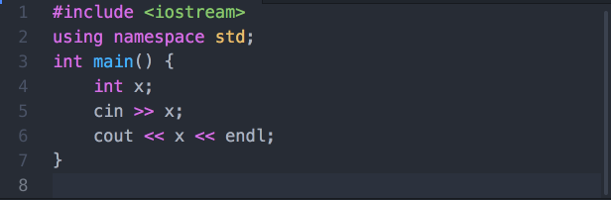
Problem 3
031003
The following C++ program reads in an integer (int) and then output it to screen.
Can you make change to the program so that it reads in two integers, and output both their sum and their product?

Slide 6
Problem 4
031004
Write a complete C++ program that reads two integers into two int variables a and b, and outputs both the quotient and the remainder when a is divided by b. For example, if a = 10 and b = 3, then the output should be as follows.

Slide 7
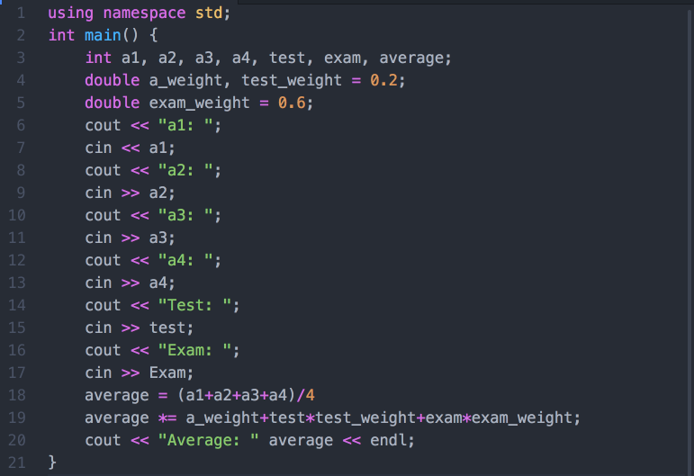
Problem 5
031005
What are the problems in the following program? Can you fix them? (hint: first guess what this program wants to achieve)

Slide 8
CHALLENGES
Optional.
For those who would like to challenge yourselves. Even for those of you who are beginners in C++ programming, it’s highly recommended for you to take a look at these problems and try to tackle them as well.
You are welcome to discuss these problems in the Moodle forum.

Slide 9
Challenge 1 Modulo operations & overflow
032001
Consider the following line of code:
int product = 654321*123456;
What is the output? Try it in a program. Does it match your expectations?
=====
This unexpected behaviour is called “arithmetic overflow”, which occurs when the size of number is larger than a certain upper-bound. For int, this is 2³² − 1 ≈ 2 * 10⁹.
To resolve this issue, you can try these approaches:
Use a larger data type, eg: “long long”, “double” etc.
Use modulo operations - Sometimes it is likely that you are just interested in the N least significant figures. For example, to calculate the 9-th least significant figures of the product, you can do:
int product = 1LL*654321*123456%1000000000
Try to figure out what the prefix “1LL” does.

Slide 10
Challenge 2
032002
You may know that a = a + b can be written as a += b instead, but what if we use “chain” them together?
Some examples:
a += b += c
a *= b *= c
a += b %= c
(a += b) *= c
If the initial values for the variables of a, b and c are a = 4, b = 3, c = 2, then what will be the value of each of the above example expressions after going through each operation? Can you explain the reason behind it?

Slide 11
Challenge 3
032003
Write a program in C++ to find the average of 5 numbers using 2 variables only.

Slide 12
Challenge 4
032004
Write a program in C++ to take in a 3-digit number, and output the reverse of the digits.
For example,
if the input is 136, the output should be 631
if the input is 401, the output should be 104

